Slide 1


Slide 2
#F9402B
#F66B2B
#F99C35
#FFDE37
#C7DC51
#7CD046
#FD3769
#F04496
#8048A3
#4E60B4
#00C2FF
#009AD8

Slide 3




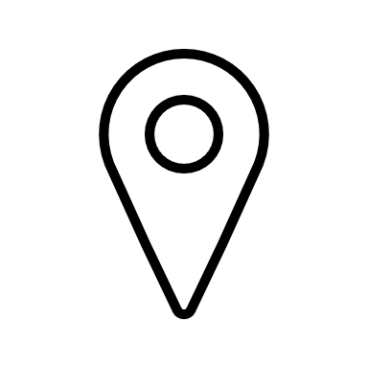



Slide 4



Slide 5
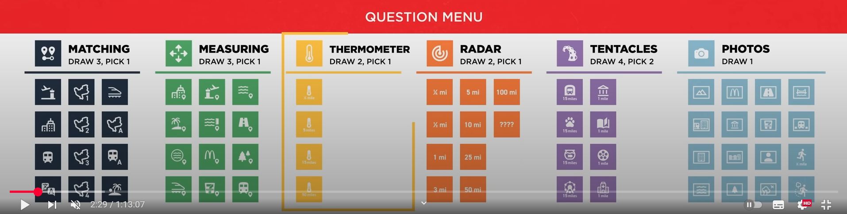


Is your nearest […] the same as mine?
A-road
(A20, A15, …)
Suburb
Metro station
Train station
Tram station
Compared to me, are you closer to or further from a […]?
Edge of the City
A-road
Large body of water (Nieuwe Maas, Oude Maas, kralingse Pplas, …)
Metro station
Train station
Tram station
Supermarket
School
Church
I’ve just travelled (at least) […]. Am I hotter or colder?
2 km
1 km
500 m
Are you within a distance of […] from me?
5 km
2 km
1 km
500 m
250 m
Send a photo of […]
A bridge
A road
A supermarket
A snack bar
A museum
A school
The tallest building you can see
The largest body of water that you can see
A 500 m strava route

Slide 6
2 km
5 km
1 km
2 km
500 m
1 km
500 m
250 m

Slide 7
